Slide 1
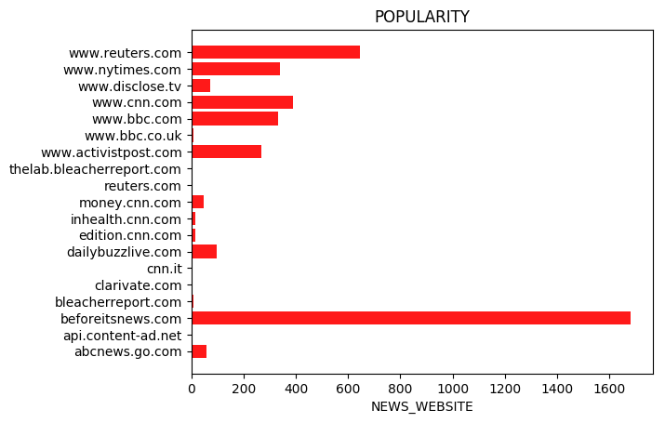
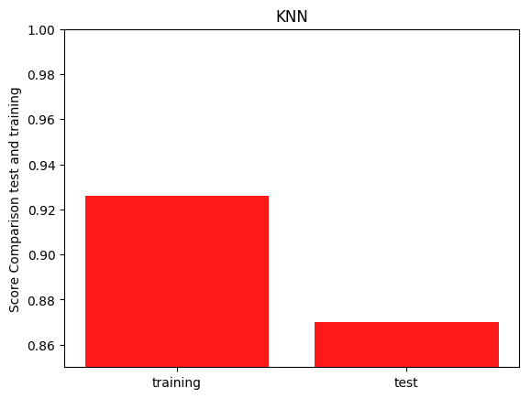
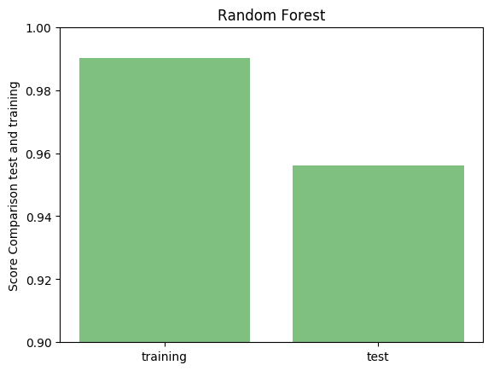
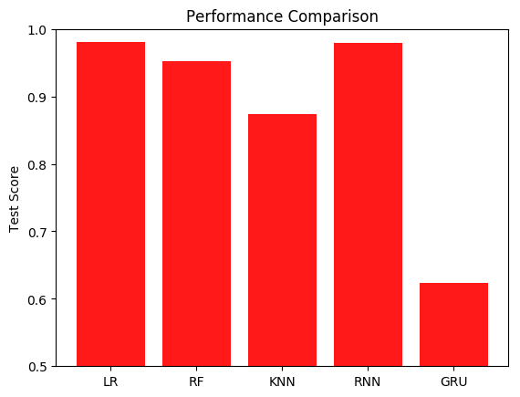
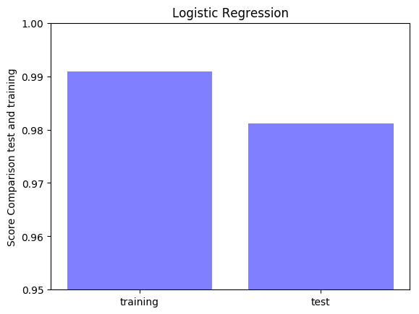

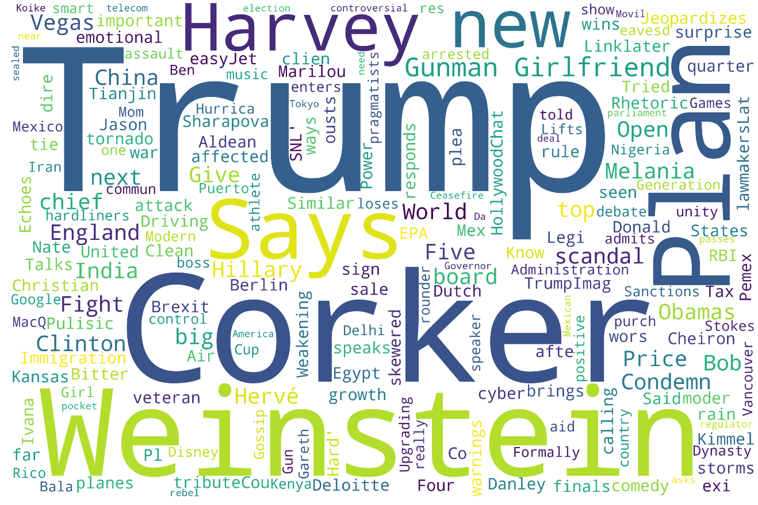

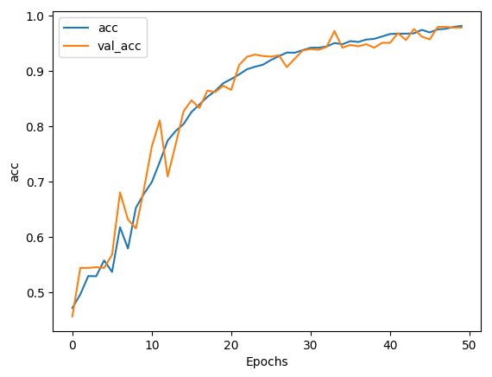
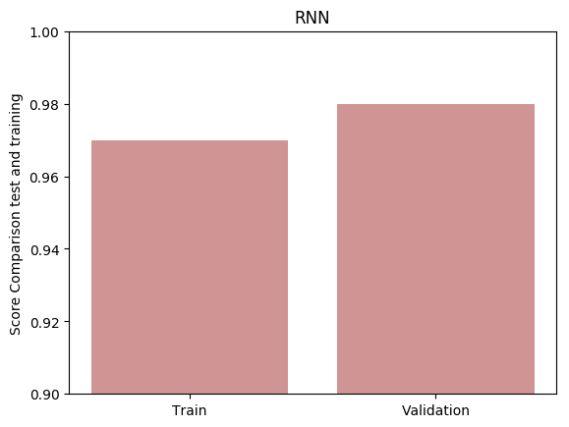
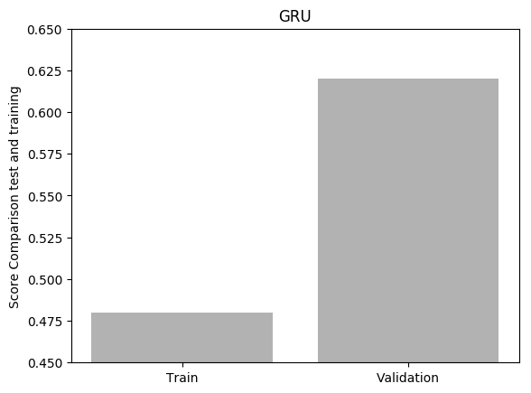

Fake News Detection –Python Project
Fatemeh Kiaie
Don Mills, Toronto, Ontario
Introduction
In recent years, due to the booming development of online social networks, fake news for various commercial and political purposes has been appearing in large numbers and widespread in the online world. With deceptive words, online social network users can get infected by these online fake news easily, which has brought about tremendous effects on the offline society already. An important goal in improving the trustworthiness of information in online social networks is to identify the fake news timely.
.
Pre-Processing and Data Exploration
Machine Learning Results
Deep Learning Results
Final Performance Comparison
Score: 0.874
Score: 0.952
News Website Population
Score: 0.981
FACT NEWS WordCloud
Conclusion
Machine learning algorithms are performing pretty good as RNN does,
Best learning method is not necessary the most complicated,
The over fitting is negligible; however, in general it is higher in RF,
More Epoch is required to get better results in GRU.
Contact: f.kiaie@gmail.com
Aim
The final objective of the project is to detect the fake news and create using an add-on app. In this project we implement the first steps that using machine learning and deep learning methods to detect the possibility of being fake or fact.
Hypothesis
The words with uncertainty will be more frequent in the Fake news.
FAKE NEWS WordCloud
Accuracy over the Epochs for RNN
Data Set
Number of features: 4
Number of Records: 3352
Number of targets: 1
Machine Learning
Text Lowerization
Remove Punctuation
Tokenization
Stemming lemmatize
Stop Word Removal
NLP Process
Deep Learning
Score: 0. 979
Score: 0. 624

